Slide 1
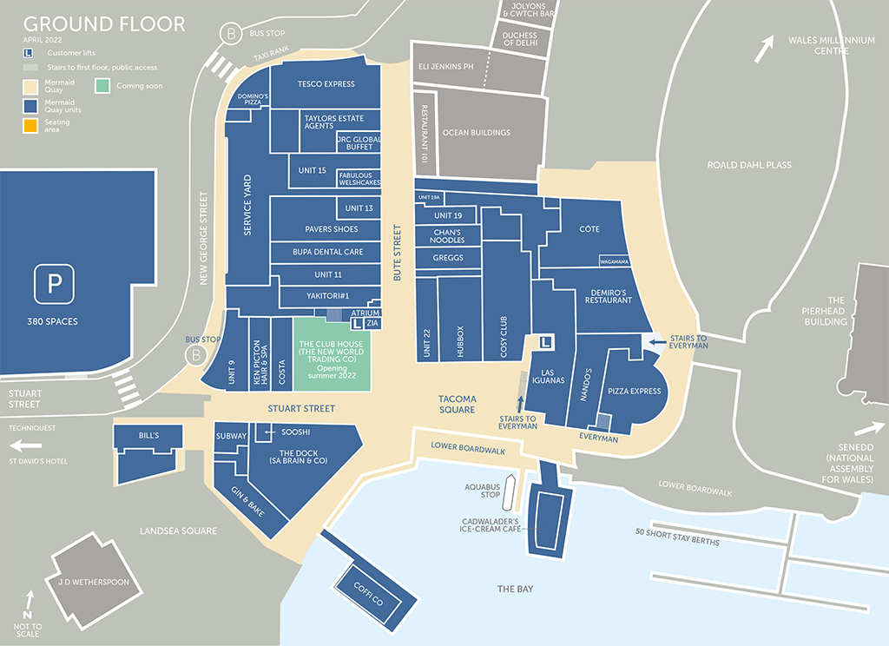
Mad
Scared
Joyful
Happy
Peaceful
Sad
Number of responses

